Slide 1
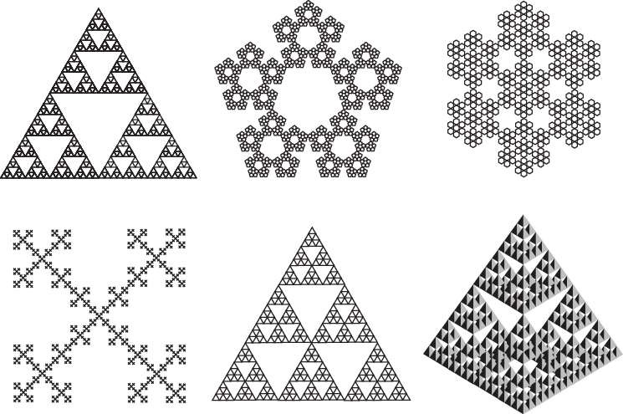
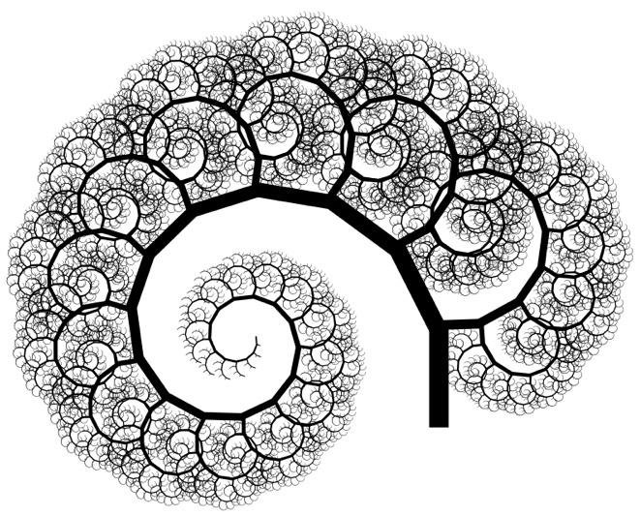
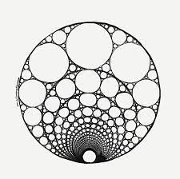
Week 06 – Fractals and Recursion

Slide 2
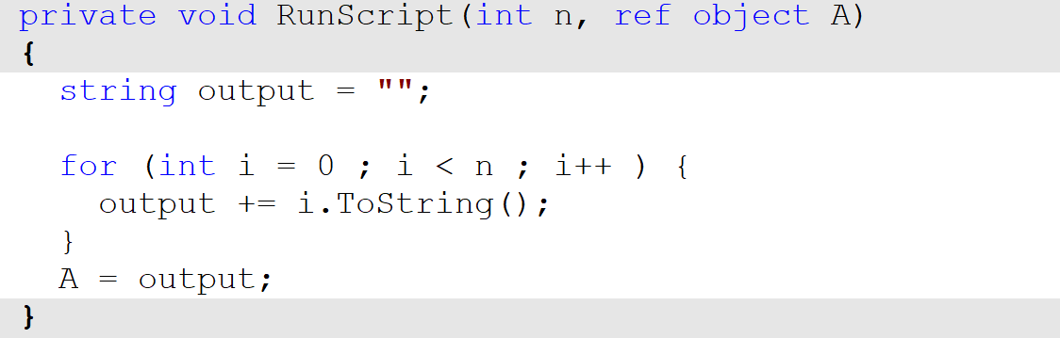
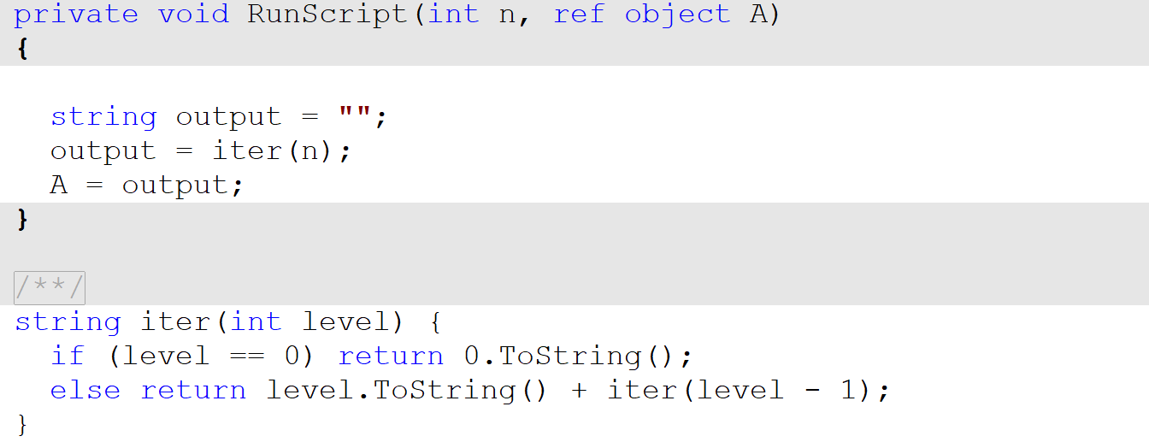
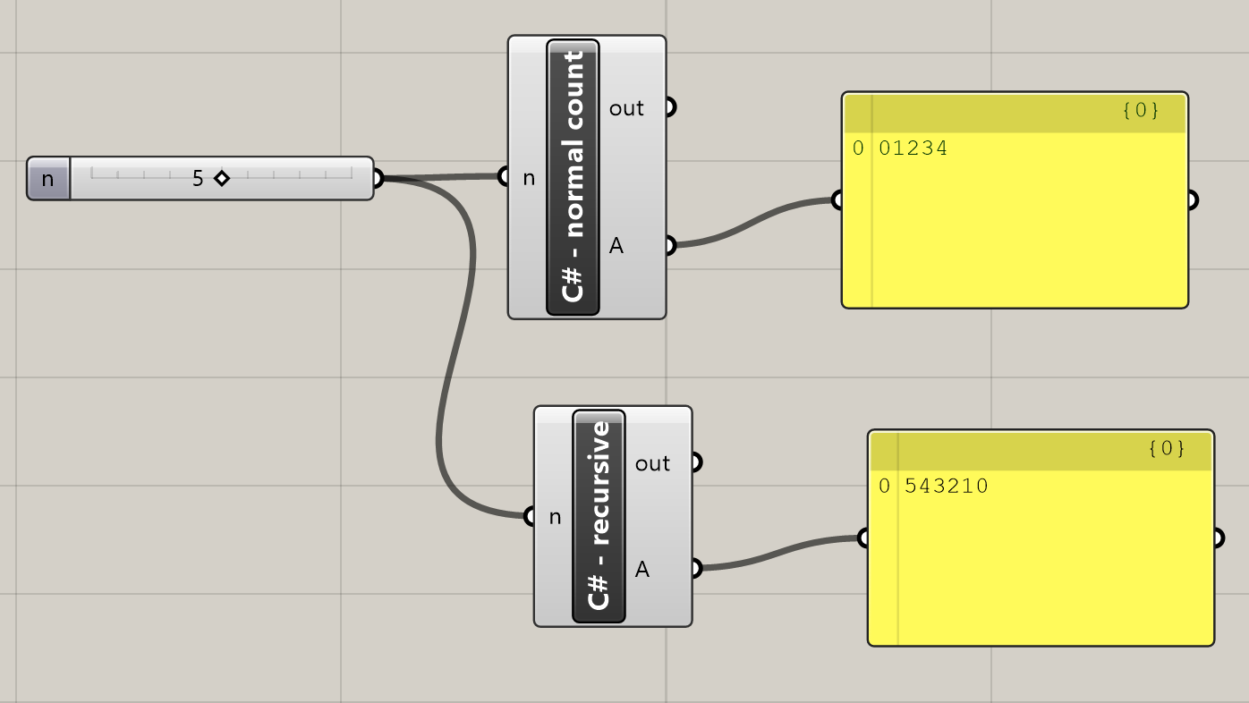
Iteration vs. recursion
>>
iteration
“recursion”

Slide 3
Iteration vs. recursion
iteration
i = 0; output = “0”
“recursion”
i = 3; output = “”

Slide 4
Iteration vs. recursion
iteration
i = 1; output = “01”
“recursion”
i = 3; output = “”
i = 2; output = “”

Slide 5
Iteration vs. recursion
iteration
i = 2; output = “012”
“recursion”
level = 3; output = “”
level = 2; output = “”
level = 1; output = “”

Slide 6
Iteration vs. recursion
iteration
i = 3; output = “0123”
“recursion”
level = 3; output = “”
level = 2; output = “”
level = 1; output = “”
level = 0; output = “0”

Slide 7
Iteration vs. recursion
iteration
i = 3; output = “0123”
“recursion”
level = 3; output = “”
level = 2; output = “”
level = 1; output = “10”
level = 0; output = “0”

Slide 8
Iteration vs. recursion
iteration
i = 3; output = “0123”
“recursion”
level = 3; output = “”
level = 2; output = “210”
level = 1; output = “10”
level = 0; output = “0”

Slide 9
Iteration vs. recursion
iteration
i = 3; output = “0123”
“recursion”
level = 3; output = “3210”
level = 2; output = “210”
level = 1; output = “10”
level = 0; output = “0”

Slide 10
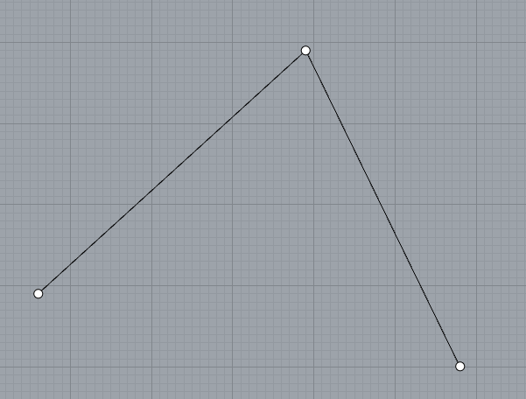
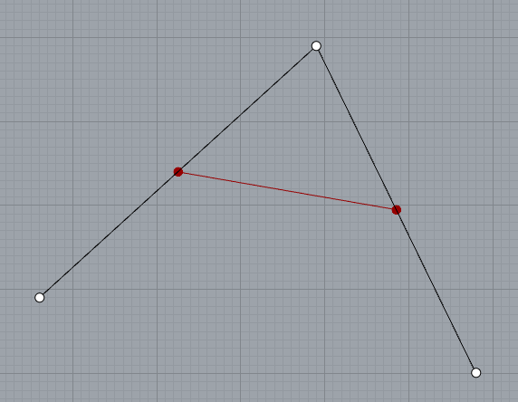
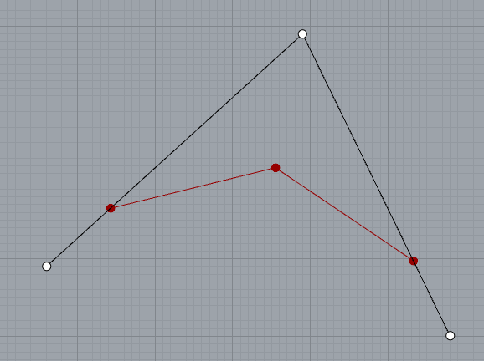
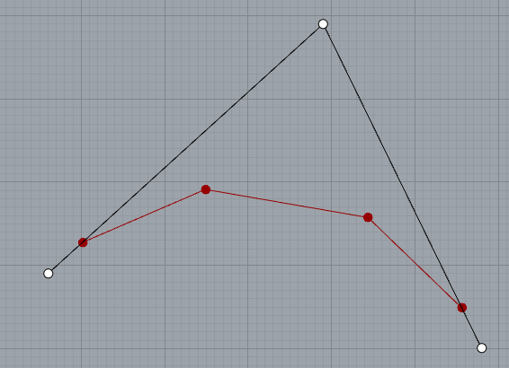
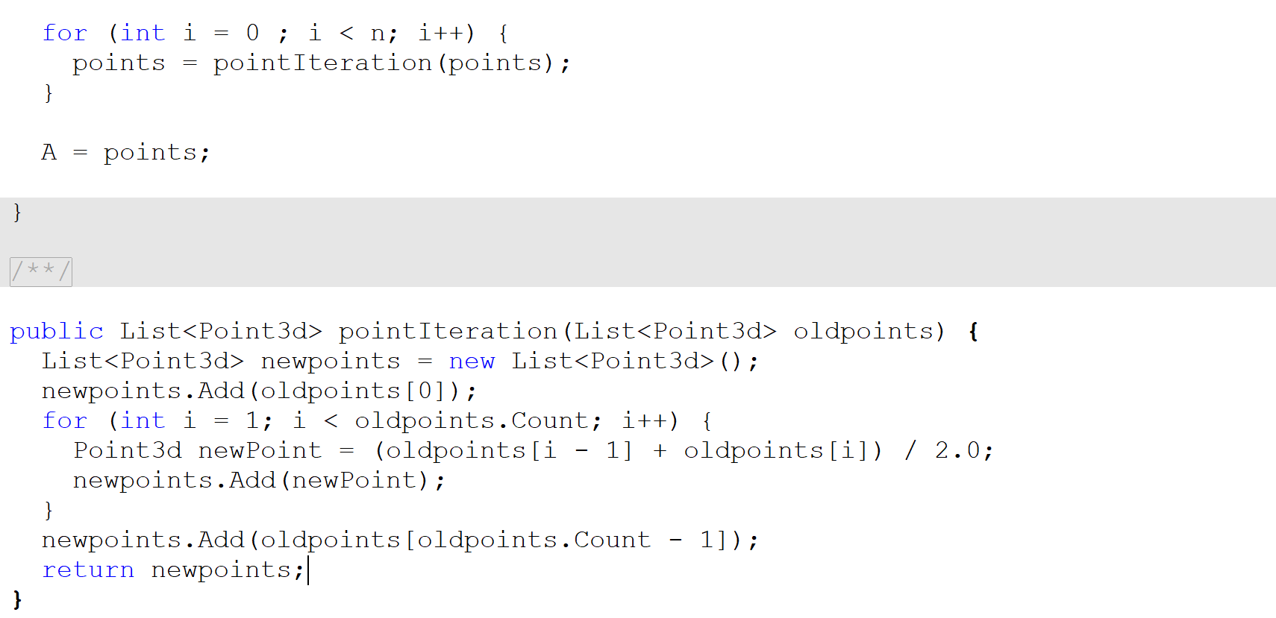
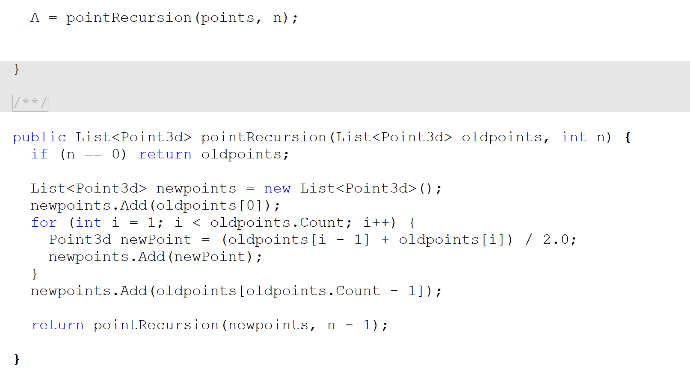
Subdivision curve
iteration
>>
recursion
>>

Slide 11
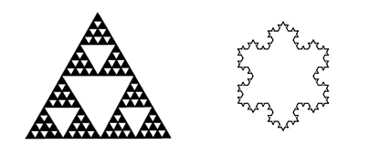
Classic fractals
Sierpinski gasket
Von Koch snowflake

Slide 12
Sierpinski gasket
>>
p2
p2
c
p20
p12
d
a
b
p0
p1
p0
p1
p2
p01
iter(p0, p1, p2)
iter(p0, p01, p20)
iter(p1, p12, p01)
iter(p2, p20, p12)

Slide 13
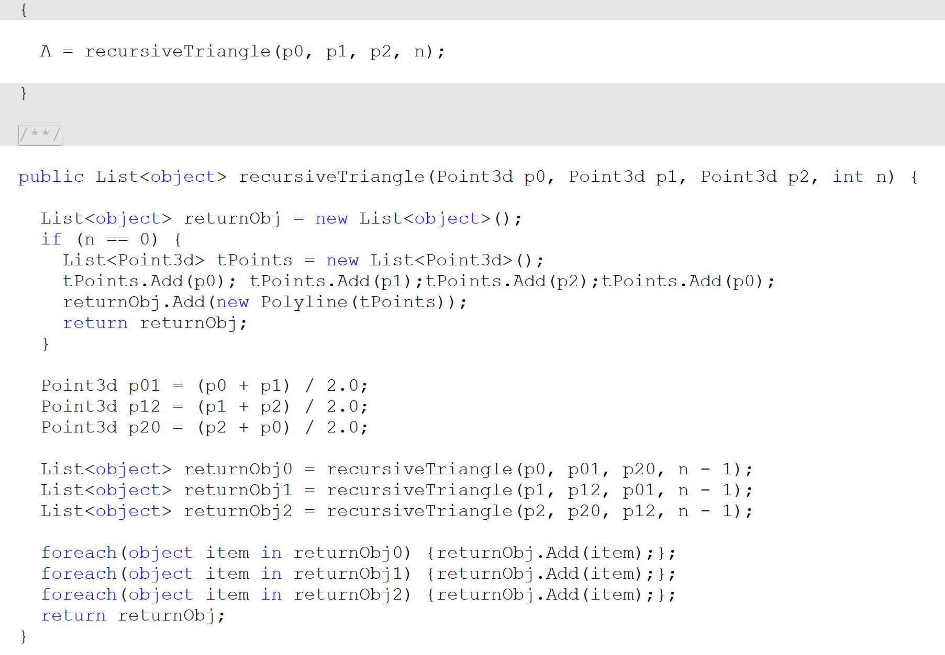
Sierpinski gasket
>>
p2
p2
c
p20
p12
d
a
b
p0
p1
p0
p1
p2
p01
iter(p0, p1, p2)
iter(p0, p01, p20)
iter(p1, p12, p01)
iter(p2, p20, p12)

Slide 14
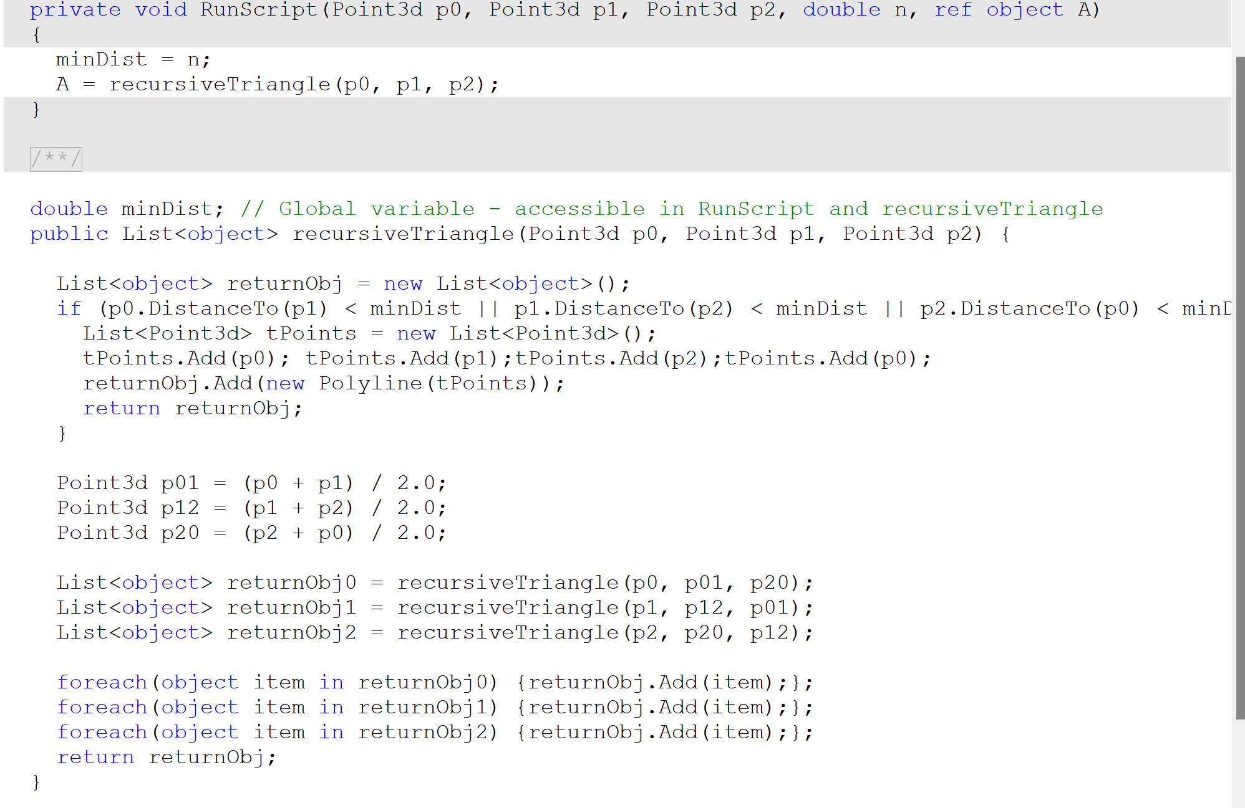
Sierpinski gasket
>>

Slide 15
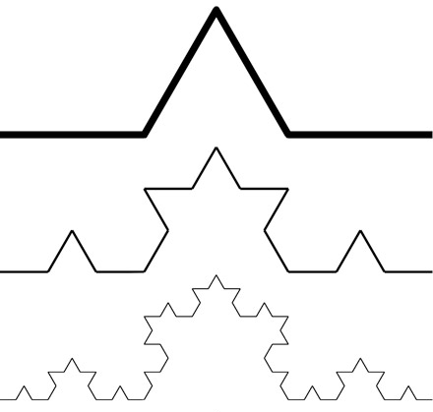
Koch Curve
>>
Given a line
p0
p1
Divide in 3,
plus the mid point
p0
p1/3
pMid
p2/3
p1
(l/3) * sqrt(3)/2
Find the normal vector and offset
p0
pMid
p1
pMidOffset
Iterate with the 4 new segments
p0
p1/3
p2/3
p1

Slide 16
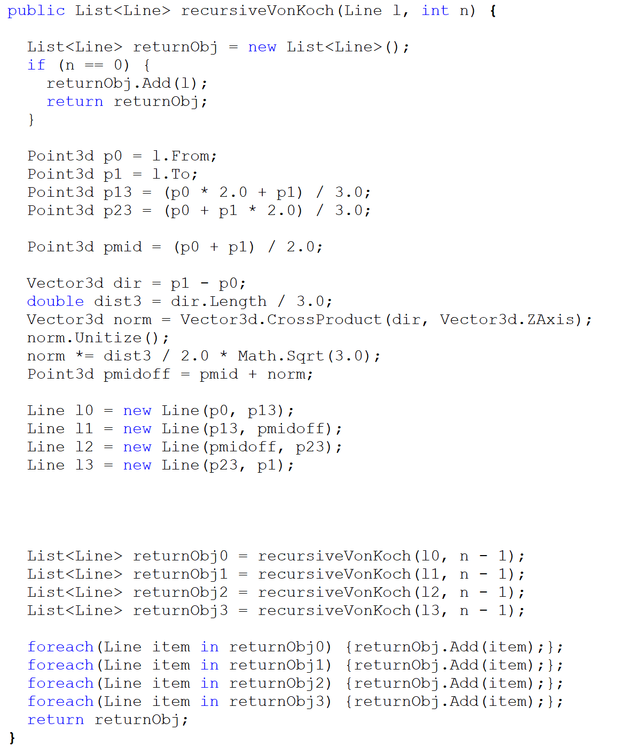
Koch Curve
Divide in 3,
plus the mid point
Find the normal vector and offset
Iterate with the 4 new segments

Slide 17
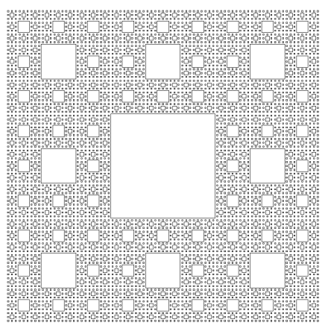
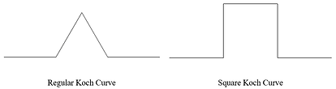
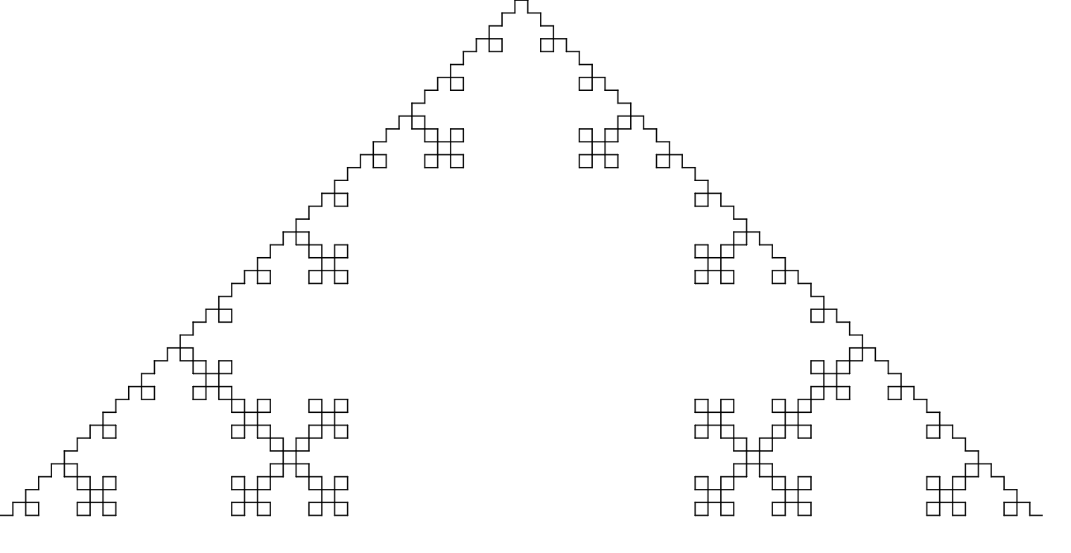
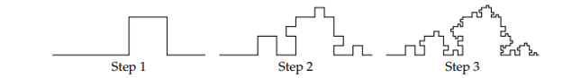
Homework
Modify the examples to produce 2 of the following:
Sierpinski carpet - based on subdivision of a square instead of a triangle;
Square Kock Curve – based on subdivision of a line into 5 segments instead of 4
A fractal of your own choosing

Slide 18
X`

